Slide 1
THE EXCRETORY SYSTEM
By: Iqra Syed, Kylie Tkalcic, Berenice Mendoza, Daena Yra, Angelica Aseoche, Pauline Joson, and Alaric Dela-Cruz

Slide 2
What are the major functions of the excretory system?
As our cells break down proteins, they produce wastes such as ammonia, which can be very harmful if it is not removed from our bodies.
The function of the excretory system is to remove these wastes, known as excretion.
The main organ in this system is the kidney, but several other organs are involved as well, including the skin and the liver.
References:
Science in Action 8, 2004

Slide 3
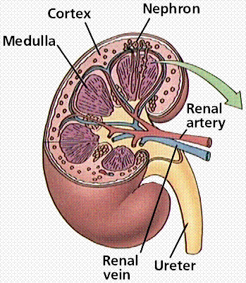
Kidney
The renal artery takes unfiltered blood from the heart to the kidney.
Through filtering units called nephrons, the kidney filters the blood - straining out the unwanted urea, water, and other wastes, thus producing urine.
Also, smaller vessels reabsorb water and other nutrients from the nephron, and then the filtered blood is transported to the heart through the renal vein.
References:
Science in Action 8, 2004
http://www.ehow.com/about_5158376_main-function-excretory-system.html
http://www.emc.maricopa.edu/faculty/farabee/biobk/biobookexcret.html

Slide 4
Liver
Ammonia and other chemicals, poisons, and toxins are converted by the liver into urea
Urea is a less harmful substance, but it still needs to be excreted.
The urea is then released into the bloodstream to be filtered and removed by the kidney.
References:
Science in Action 8, 2004
http://www.ehow.com/about_5158376_main-function-excretory-system.html

Slide 5
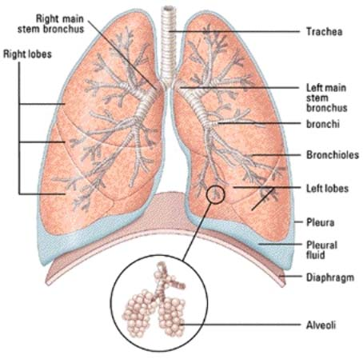
Lungs
When our cells use energy, carbon dioxide is created as a byproduct.
The lungs remove excess carbon dioxide from our body when we breathe out.
References: http://www.ehow.com/facts_5522079_function-lungs-excretory-system.html

Slide 6
Skin
The skin has sweat glands, which produce sweat.
Extra water, salt, urea, and uric acid are mixed with the sweat, and are excreted through sweating.
When we have extra body heat, the sweat produced evaporates and cools the body.
References:
http://qldscienceteachers.tripod.com/junior/biology/excretory.html
Science in Action 8, 2004

Slide 7
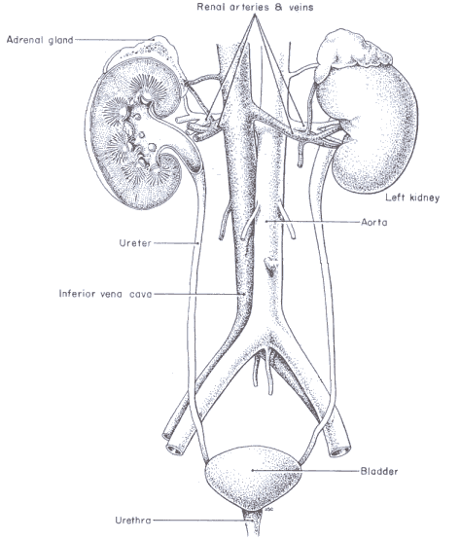
Urinary Bladder, Ureter, and Urethra
The ureters are tubes that transport the urine produced by the kidneys to the bladder.
The bladder is where the urine is stored until it can be excreted.
The urethra is where the urine exits and is removed from the body.
References:
Science in Action 8, 2004
http://www.whitman.edu/biology/vpd/excquiz.html

Slide 8
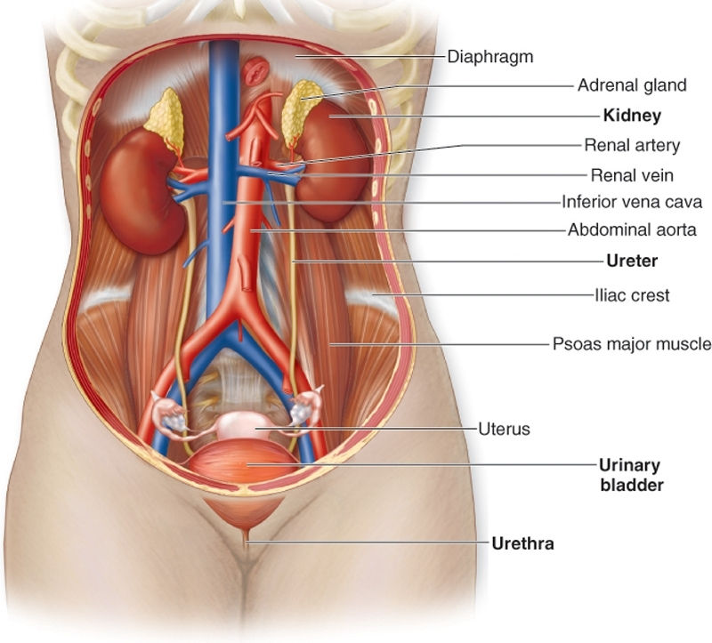

Slide 9
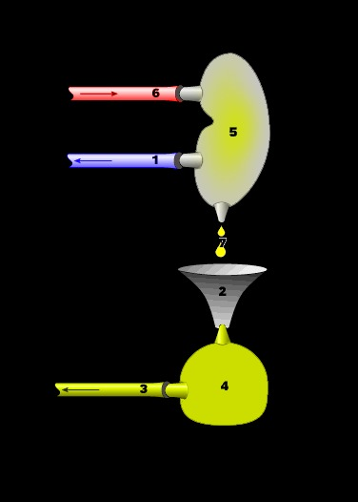
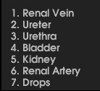
References:
http://www.whitman.edu/biology/vpd/excquiz.html
Renal Artery
Kidney
Renal Vein
Ureter
Urethra
Bladder

Slide 10
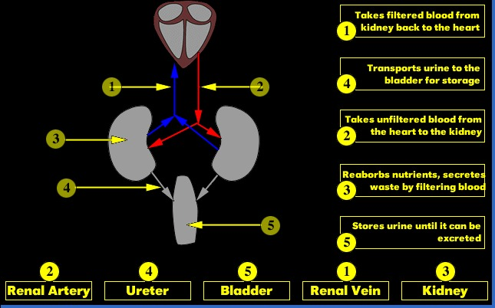

Slide 11
What other body systems interact with the excretory system?
The endocrine system controls the excretory system whenever you drink too much or if you are dehydrated. It releases chemical signals (hormones) to either allow more urine production or less.
The digestion system comes first before the excretory system function. First, the intestines digests whatever comes in (food) and gives it to the excretory system. The kidney then, removes all that waste and other unwanted substances through the urine.
The circulatory system carries the waste to the kidney, but not all wastes goes to the kidney.
http://www.biology4kids.com/files/systems_excretory.html
http://www.buzzle.com/articles/how-does-the-kidney-work.html
http://wiki.answers.com/Q/What_do_the_kidneys_do
http://wiki.answers.com/Q/How_does_the_Circulatory_system_work_together_with_the_Excretory_system_in_a_humans_body&src=ansTT

Slide 12
Fun Facts
Blood passes through the kidney and the kidney filters the blood
Unwanted urea, water, and other salts produce urine from filtered blood
The kidney is 10cm long
The bladder can store about 1L of urine
Sweat contains salt removed from the body
As urine enters the bladder, the bladder expands
Bladder is a sac covered in muscle tissue
References: [insert websites here]

Slide 13
What is Chronic Kidney Disease
Chronic kidney disease occurs when one suffers from gradual and usually permanent loss of kidney function over a period of time. This happens gradually, usually months to years.
With loss of kidney function, there is an increase of water, waste, and toxic substances, in the body, that are normally excreted by the kidney. Loss of kidney function also causes other problems such as anemia, high blood pressure, acidosis (excessive acidity of body fluids), disorders of cholesterol and fatty acids, and bone disease.

Slide 14
Chronic kidney disease is divided into five stages of increasing severity:
Stage | Description | GFR* mL/min/1/73m²
1 | Slight kidney damage with normal or increased filtration | More than 90
2 | Mild decrease in kidney function | 60-89
3 | Moderate decrease in kidney function | 30-59
4 | Severe decrease in kidney function | 15-29
5 | Kidney failure | Less than 15 (or dialysis)

Slide 15
Chronic Kidney Disease
Symptoms of Chronic Kidney Disease:
Swelling
Fatigue
Skin Rash/Itching
Metallic Taste In Mouth/Ammonia Breath
Nausea and Vomiting
Shortness of Breath
Feeling Cold
Dizziness and Trouble Concentrating, Headaches
Leg Pain
Bone Pain
Chest Pain
High Blood Pressure
Causes of Chronic Kidney Disease:
High Blood Pressure
Diabetes
Hardening of the Arteries
Heart Disease
Liver Disease
High Cholesterol
Body Systems that are Affected by Chronic Kidney Disease:
Respiratory System
Circulatory System
Digestion System

Slide 16
Chronic Kidney Disease
Treatment for Chronic Kidney Disease:
The goal of treatment is to prevent or slow
Additional damage to your kidneys. You can
Take steps at home to help control your
kidney disease:
Make exercise a routine part of your life.
Avoid taking medicines that can damage your kidneys, like ibuprofen (such as Advil), naproxen sodium (Aleve), and celecoxib (Celebrex).
Avoid dehydration.
Do not smoke or use other tobacco products.
Do not drink alcohol or use illegal drugs.
As part of your ongoing treatment for
Chronic kidney disease, you may be
prescribed a blood pressure medicine
Diagnosis of Chronic Kidney Disease:
Biopsy
Ultrasound
Blood Tests
Electrolyte levels and acid-base balance
Estimated GFR (eGFR)
Creatinine and urea (BUN) in the blood
References:
http://www.emedicinehealth.com/chronic_kidney_disease/article_em.htm

